Slide 1
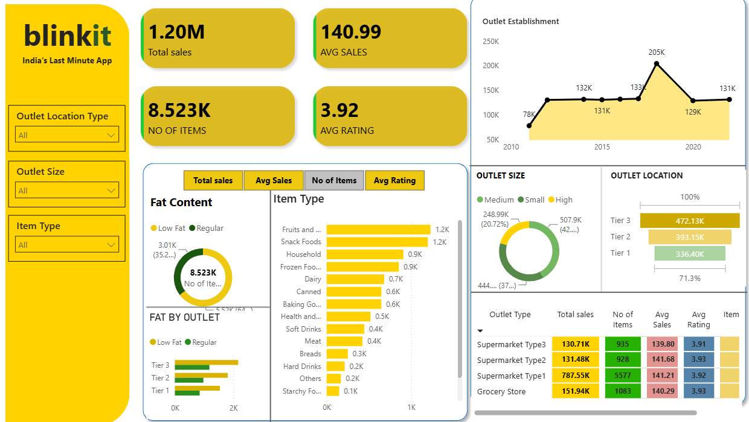
Blinkit Sales Dashboard-Power BI

Slide 2
Key Insights
Total Sales: 1.20M
Total Items: 8.523K
Average Sales: 140.99
Average Rating: 3.92
Supermarket Type1 has the highest sales among outlet types.
Tier 3 outlets have the highest sales among outlet locations.

Slide 3
Dashboard Features
KPI cards for key metrics
Interactive slicers
Outlet establishment trend analysis
Item-type analysis
Fat-content analysis
Outlet size and location analysis
Interactive tables for outlet performance
Conclusion: The dashboard provides an interactive overview
of Blinkit sales performance and helps identify important
trends across outlets, items, and locations.

